Slide 1
Yav pem suab academy Report to academy council Tuesday, October 3, 2023
Presented by:
Mary Lor, M.A.
Assistant Principal

Slide 2
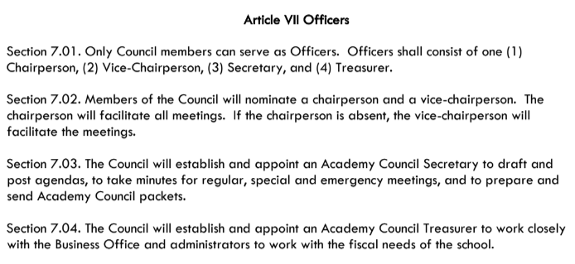
2023-24 LCAP PROGRESS UPDATE
Informational Item #6
7.1.1 Review Academy Council Duties and Responsibilities

Slide 3
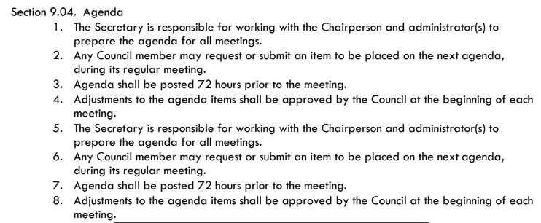
2023-24 LCAP PROGRESS UPDATE
Informational Item #6
7.1.1 Review Academy Council Duties and Responsibilities

Slide 4
2023-24 LCAP PROGRESS UPDATE
Informational Item #6
7.1.2 Present Tiger Society Updates – AP Yang
7.1.3 Report out on ELAC Meeting – AP Yang
7.1.4 Review of EL Reclassification Process and Timeline – AP Yang

Slide 5
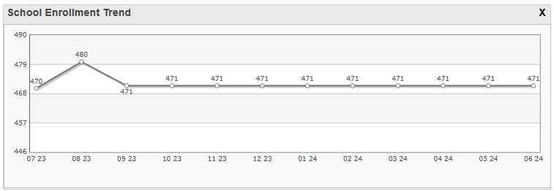
2023-24 LCAP PROGRESS UPDATE
Informational Item #6
7.1.2 2023-24 Enrollment & Attendance

Slide 6
2023-24 LCAP PROGRESS UPDATE
Informational Item #6
7.1.5 2023-24 Enrollment & Attendance
Grade | Capacity | Registered (Previous Month) | Registered (Current Month) | Available Space | Waiting List
TK | 24 | 24 | 24 | 0 | 3
K | 72 | 70 | 72 | 0 | 2
1 | 72 | 58 | 58 | 14 | 0
2 | 72 | 60 | 60 | 12 | 0
3 | 72 | 54 | 54 | 18 | 0
4 | 72 | 69 | 69 | 3 | 0
5 | 72 | 72 | 72 | 0 | 4
6 | 72 | 64 | 62 | 10 | 0
TOTAL | 528 | 471 | 471 | 57 | 9

Slide 7
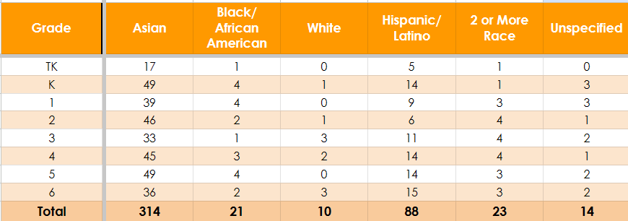
2023-24 LCAP PROGRESS UPDATE
Informational Item #6
7.1.5 2023-24 Enrollment & Attendance

Slide 8
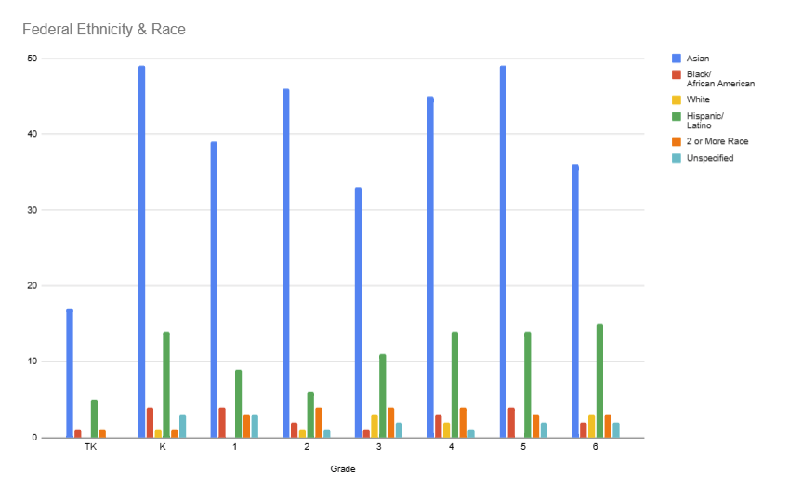
2023-24 LCAP PROGRESS UPDATE
Informational Item #6
7.1.5 2023-24 Enrollment & Attendance

Slide 9
2023-24 LCAP PROGRESS UPDATE
Informational Item #7
7.1.5 Staffing, Teaching and Learning
Department | Positions | Filled | Vacant | Percentage
Administrators | 3 | 3 | 0 | 100.00%
Core Teachers | 22 | 22 | 0 | 100.00%
Non-Core Teachers | 6 | 4 | 2 | 66.66%
Instructional Assistants | 22 | 17 | 5 | 77.27%
SPED Staff | 8 | 5 | 3 | 62.50%
Support Staff | 9 | 6 | 3 | 66.66%
Total | 70 | 57 | 13 | 78.84%
Notes:
SPED STAFF VACANCIES:
1. Speech Language Pathologist
2. Ed. Specialist
3. SpEd Instructional Aide
Support Staff Vacancies
Nurse
Yard
Yard

Slide 10
2023-24 LCAP PROGRESS UPDATE
Informational Item #7
7.1.5 Staffing, Teaching and Learning
Mid-Trimester 1 Progress Reports
Week of September 25th
Scholars who are not meeting grade level standards will be issued a Mid-Trimester Progress Report (Total of 175, 14 edits)
Grades TK – 2 has 52 total progress reports
Grades 3-6 has 109 total progress reports
Grading Scale
YPSA Grading Policy
YPSA Grading Scale Presented
Concerns and Potential Outcomes
Notes:
SPED STAFF VACANCIES:
1. Speech Language Pathologist
2. Ed. Specialist
3. SpEd Instructional Aide
Support Staff Vacancies
Nurse
Yard
Yard

Slide 11
2023-24 LCAP PROGRESS UPDATE
Informational Item #7
7.1.5 Staffing, Teaching and Learning
HET Reboot
Administrative Walk Throughs and Observations
Uncluttered classroom
Morning procedures
Agenda
Town Hall Meeting
Movement
Australia
Walkthrough Data Tracking Sheet
Professional Development Schedule & Training
Statewide Testing – ELPAC Interim, NWEA (Fall), CAASPP Interim
Soft Music Background
Lighting
Written Procedures
Collaborative Learning Club
Parent/Teacher Communication
Notes:
SPED STAFF VACANCIES:
1. Speech Language Pathologist
2. Ed. Specialist
3. SpEd Instructional Aide
Support Staff Vacancies
Nurse
Yard
Yard

Slide 12
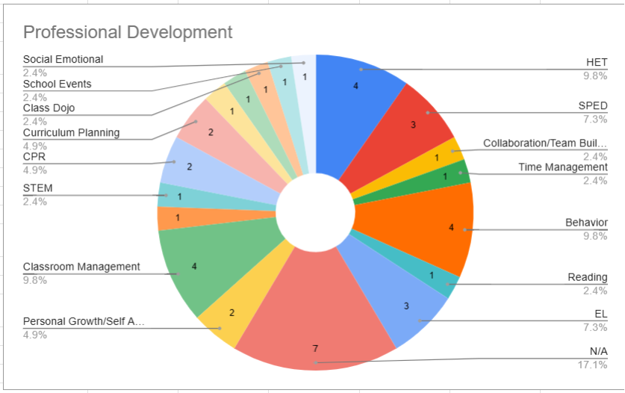
2023-24 LCAP PROGRESS UPDATE
Informational Item #6
7.1.5 Staffing, Teaching and Learning
Notes:
SPED STAFF VACANCIES:
1. Speech Language Pathologist
2. Ed. Specialist
3. SpEd Instructional Aide
Support Staff Vacancies
Nurse
Yard
Yard

Slide 13
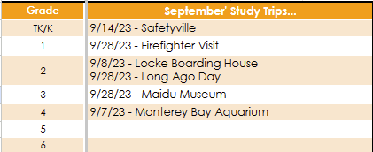
2023-24 LCAP PROGRESS UPDATE
Informational Item #6
7.1.5 Staffing, Teaching and Learning
Study Trips – Being There vs. Being Here
YPSA Mentorship & Onsite Observations
4 mentors – Intern eligible mentees
2 master teachers – Local College Student
(25 total hours of total observation)
Notes:
SPED STAFF VACANCIES:
1. Speech Language Pathologist
2. Ed. Specialist
3. SpEd Instructional Aide
Support Staff Vacancies
Nurse
Yard
Yard

Slide 14
2023-24 LCAP PROGRESS UPDATE
Informational Item #6
7.1.6 Review School Attendance Data on SART/SARB
Teachers take attendance by 9:30am daily. Automated message is sent home to parents of scholars who are absent for the day no later than 12:30pm. Teachers communicate with family to check in on the scholar’s well-being and to share any information on loss of learning opportunities and discuss how the learning can be made up.
Attendance clerk will follow up. After 3 failed attempts, school administrator or designee conducts a home visit to do a wellness check and secure a completed absence verification form if it had not been completed by front office or teachers.

Slide 15
2023-24 LCAP PROGRESS UPDATE
Informational Item #6
7.1.6 Review School Attendance Data on SART/SARB
School Attendance Review Team, (SART) letters are sent to parents of students with three or more unexcused absences.
School Attendance Review Board (SARB) begins on the sixth unexcused absence at the board level for the appropriate action to address the student’s truancy.

Slide 16
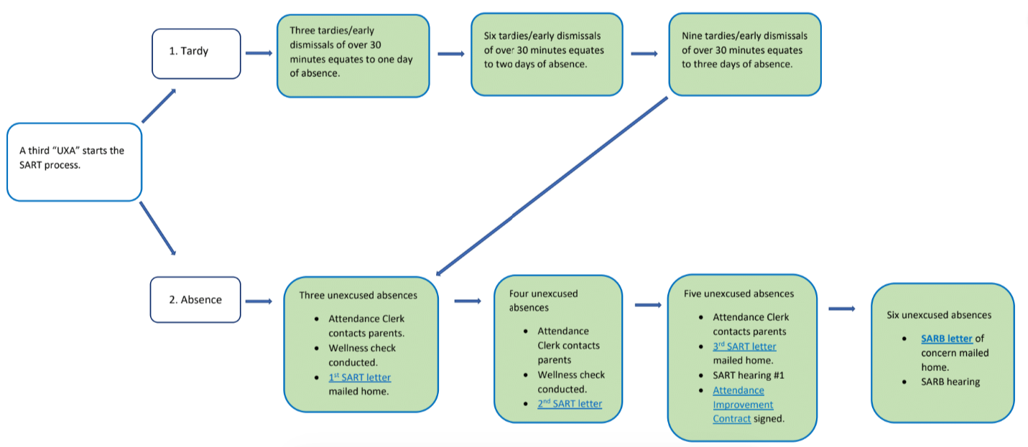
2023-24 LCAP PROGRESS UPDATE
Informational Item #6
7.1.6 Review School Attendance Data on SART/SARB

Slide 17
2023-24 LCAP PROGRESS UPDATE
Informational Item #6
7.1.7 Teacher Created Assessment Data and Next Steps
Assignments are logged onto PowerSchool
Teacher created data sheets
Standards/Testing Format Aligned
Daily Collaboration (3:00pm – 5:00pm)
Collaborative Inquiry Process
Data Collaborative Inquiry Expectations and Norms

Slide 18
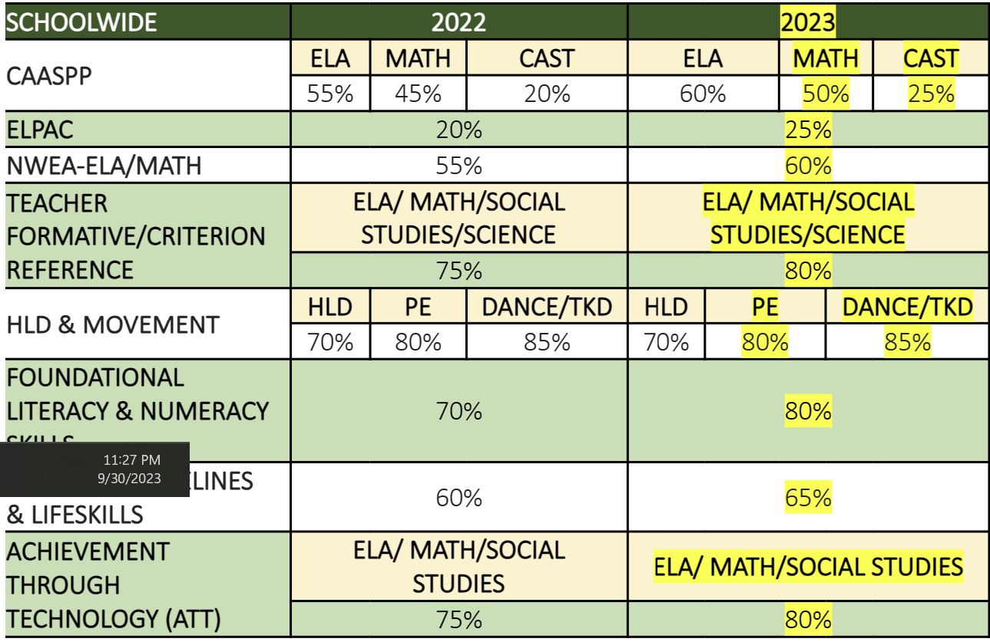
2023-24 LCAP PROGRESS UPDATE
Informational Item #7
7.1.7 Teacher Created Assessment Data and Next Steps

Slide 19
2023-24 LCAP PROGRESS UPDATE
Informational Item #7
7.1.8 Movement (Dance, Taekwondo, & PE) Instructional Program
Daily Schedule (MW or TTh)
Program resets each trimester
Class | Grade | Time | Minutes of Instruction
Session 1 | 5th | 8:00 a.m. – 9:00 a.m. | 60 minutes
Session 2 | 4th | 9:00 a.m. – 10:00 a.m. | 60 minutes
Session 3 | 6th | 10:15 a.m. – 11:15 a.m. | 60 minutes
Session 4 | 3rd | 11:15 a.m. – 12:15 p.m. | 60 minutes
Session 5 | 1st | 1:00 p.m. -2:00 p.m. | 60 minutes
Session 6 | 2nd | 2:00 p.m. – 3:00 p.m. | 60 minutes

Slide 20
2023-24 LCAP PROGRESS UPDATE
Informational Item #7
7.1.8 Movement Program
Physical Education Instructional Program
 | August | September | October | November
Components | Awareness of Personal Space | Strengthening of Muscles will prevent injuries | Body components and willful participation | Identify & demonstrate the attributes in a Physical Activity
Standards (Total of 300) | Students demonstrate the motor skills and movement patterns needed to perform a variety of physical activities. | Students assess and maintain a level of physical fitness to improve health and performance | Students demonstrate knowledge of physical fitness concepts, principles, and strategies to improve health and performance. | Students demonstrate and utilize knowledge of psychological and sociological concepts, principles, and strategies that apply to the learning and performance of physical activity.

Slide 21
2023-24 LCAP PROGRESS UPDATE
Informational Item #7
7.1.8 Movement Program
Dance Instructional Program
 | 1st grade | 2nd Grade | 3rd Grade | 4th Grade | 5th Grade | 6th Grade
Components | Time & Rhythm | Locking | Breaking | Popping | Musically | Expression
Key Points | Tempo & Rhythmic Patterns | Freezing from a fast movement | Power moves and freezes | Jerking or Twitching Movements | Practice and Clean | Culminating Performance
Standards (183 Total) | Up-lock Down-lock Wrist roll Uncle Sam Performance | Tom & Jerry Flicks Pacing Leo Walk Scooby Doo Which-a-way Performance | Top Rock Two Step Indian Step Coffee Grinder CC Performance | Fresno Tracing Wave Move Performance | Sadness Happy Instruments Lyrics Performance | Song Theme Group Identification Performance

Slide 22
2023-24 LCAP PROGRESS UPDATE
Informational Item #7
7.1.8 Movement Program
Taekwondo Instructional Program
 | White Belt | Orange Belt | Yellow Belt | Camo Belt | Green Belt | Purple Belt
Board Break Requirements |  | Back fist | Knife Hand Strike Jump front kick | Step Reverse side Kick Reverse side kick | Ridge hand strike, round kick (face level) Knife hand strike, #1 jump side kick
Key Points | Songham Basics, Songahm 1 Form One-step Sparring | Songahm 2 Basics Songahm 2 Form One-step Sparring | Songham 3 Basics Songham 3 Form One-step Sparring | Songham 4 Basics Songham 4 Form Sparring Segment | Songham 5 Basics Songham 5 Form Sparring Segment | In Wha 1 Basics In Wha 1 Form
Standard (287 Total) | Standard 1 thru 37 37 Standard Objectives | Standard 38 thru 80 42 Standard Objectives | Standard 81 thru 129 49 Standard Objectives | Standard 130 thru 184 55 Standard Objectives | Standard 185 thru 237 53 Standard Objectives | Standard 238 thru 287 50 Standard Objectives

Slide 23
2023-24 LCAP PROGRESS UPDATE
Informational Item #6
7.1.9 Expectations for Parent Teacher Conferences
Parent Teacher Conferences
Purpose: A meeting between the Teacher, Parent, and Scolar to discuss the scholar’s progress at school, what he or she is learning, how he or she is doing, and the supports or intervention in place.
Before the Conference | During the Conference | After the Conference
Know your scholar Know your curriculum Know your parents Know what strategies can help the scholar to make improvements Know why and how those strategies can be effective | Share the standards Share current progress Share goals (short and long term) Share work samples & rubrics Answer questions Sign & Date report cards Provide a copy of the report card to the parent/guardian | Send home a thank you letter Contact missed appointments to reschedule Keep an open communication

Slide 24
2023-24 LCAP PROGRESS UPDATE
Informational Item #7
7.1.10 Review and Provide Update LCAP Priorities
LCAP Priority Log 23-24
Six Goals
Highly qualified teachers (ILP, HET Strategies, and Subject Content)
Safe and well-maintained facilities
Adequate resources to support staff for completion of duties
Scholar access to standards-aligned materials
Increased scholar achievement (Teacher Created
Assessments, Reading Fluency)
6. Increase Scholar Attendance
Task Completion Rate | To Date Achievement Rate | Goal
17% | 63% | 100%

Slide 25
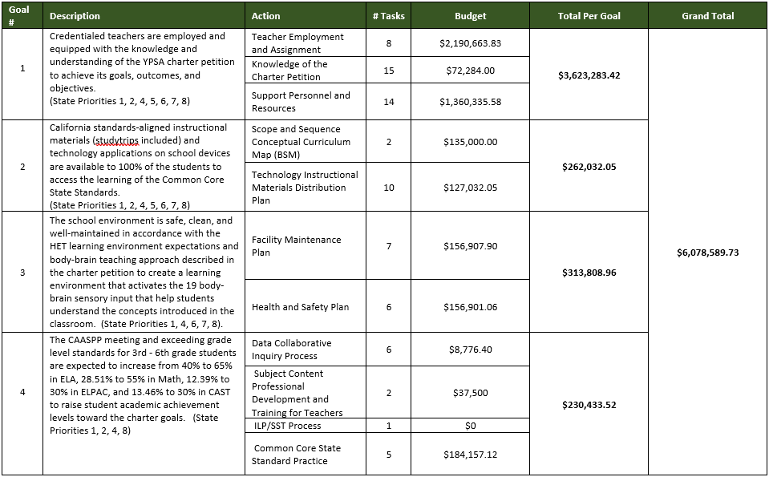
2023-24 LCAP PROGRESS UPDATE
Informational Item #7
7.1.10 Review and Provide Update LCAP Priorities

Slide 26
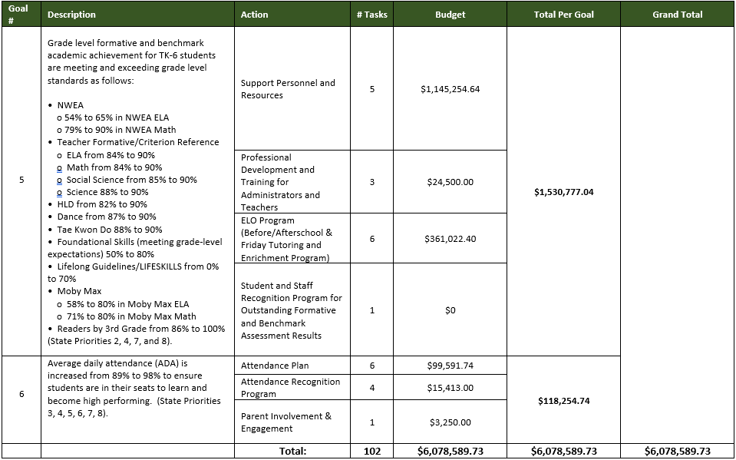
2023-24 LCAP PROGRESS UPDATE
Informational Item #7
7.1.10 Review and Provide Update LCAP Priorities

Slide 27
2023-24 LCAP PROGRESS UPDATE
Informational Item #7
7.1.11 Present the 45 Day Budget Update – CFO/CBO Megan Lao
7.1.12 Present & Adopt the Annual Programmatic Audit Report - Due to SCUSD
10/25 – CFO/CBO Megan Lao
Change in Reporting Requirements timeline
7.1.13 Adopt the CA Dashboard – Due to CDE 9/30 – CFO/CBO Megan Lao
Completed
Submitted on 9/20/22
Confirmed on 9/22/22

Slide 28
Questions?

